Slide 1



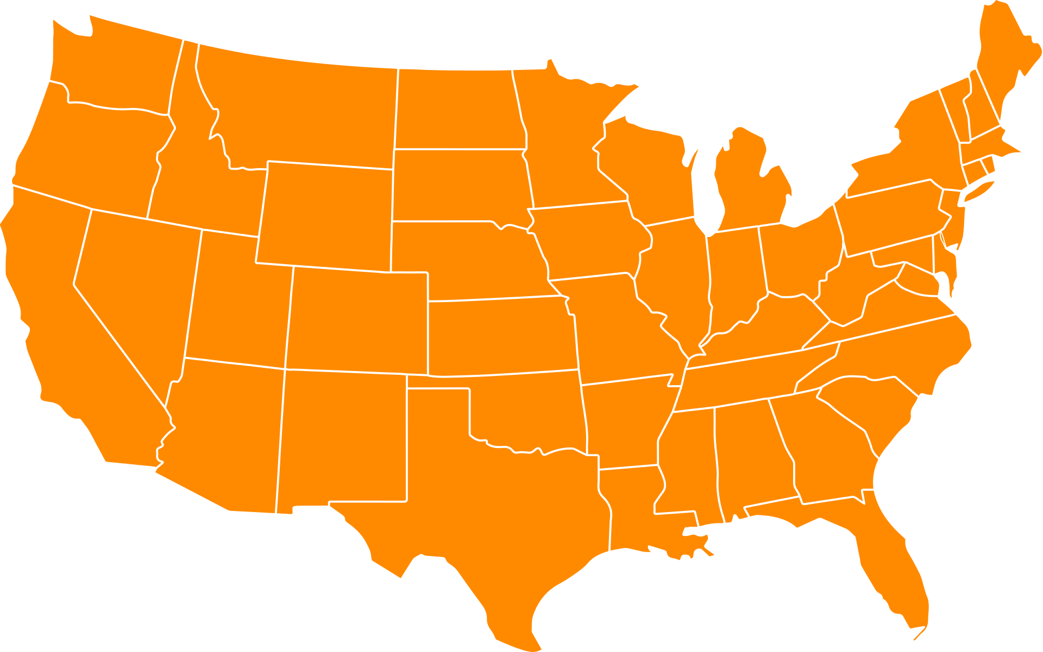

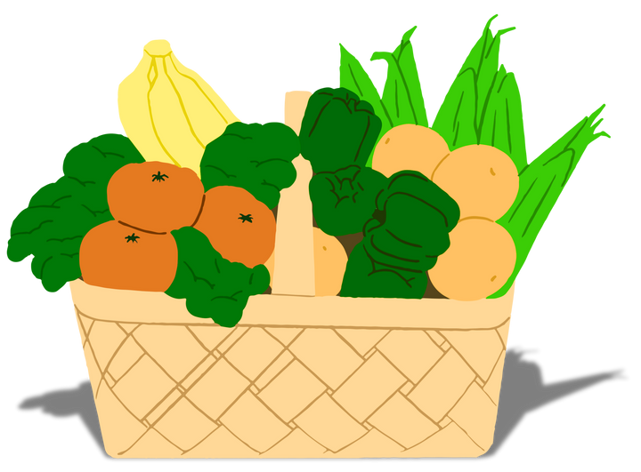


FEEDING
AMERICA
HELPING REPLACE
I
HUNGER
W TH
EALTH
Taskforce Team:
Andranique, Marlene, Omar, Sobomabo

Slide 2


About Our
Organization
Since 1979 our organization has had a hand in fighting to end hunger in America, and since then we have only gotten better at our approach.
We make healthy food easier to access.
We help families feel financially secure.
We support laws that make food available to everyone.
Learn More

Slide 3



Feeding America’s Impact
Just some of the big wins we have accomplished :
5.9
4
Billion meals given
Billion pounds food saved
8
Countless
Million pounds of disaster food
Lives touched
Learn More

Slide 4

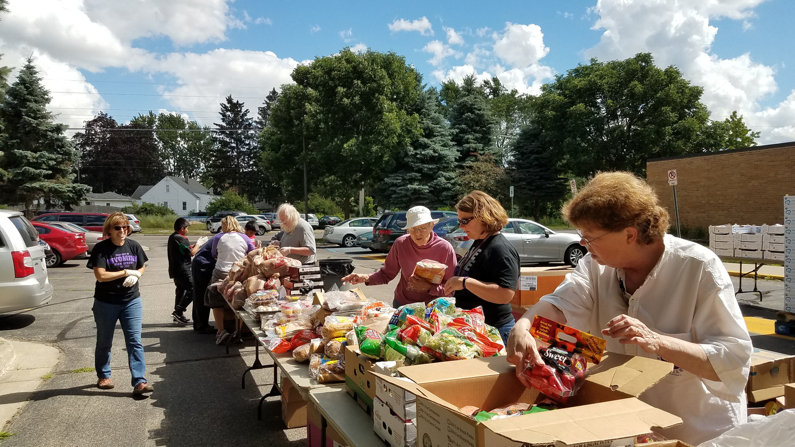

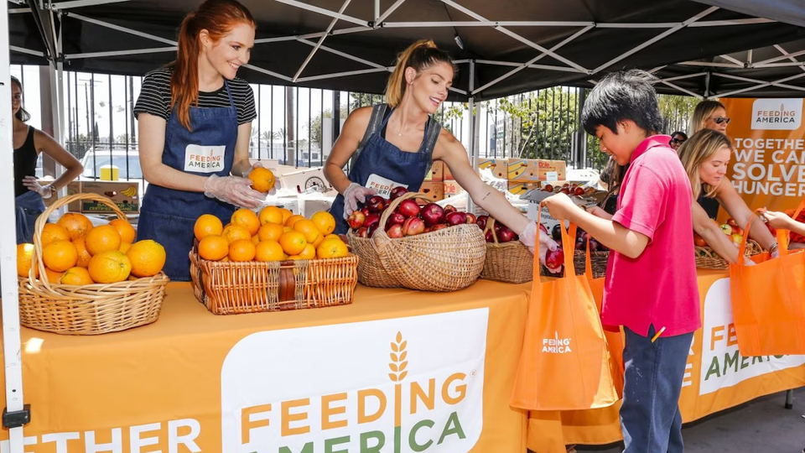

Oasis Initative
What is Oasis?
The Gift of Giving
Oasis is a new mobile farmer’s market initiative that partners with local farms to rescue excess produce at a reduced cost to identified food deserts. Which reduces food waste and provides better quality options.
“ We all deserve to have enough food to eat without worrying about if we can afford it. ”

Slide 5
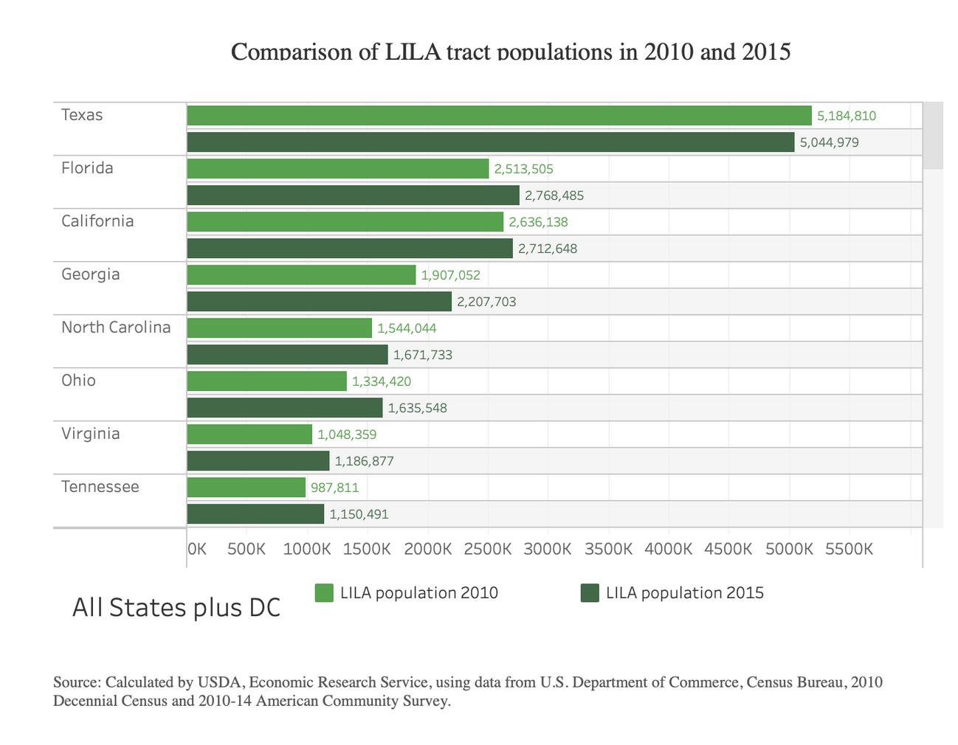
Oasis Initative
How can we help the most people?
This graph compares all LILA or Low Access Low Income populations across states. As we can see Texas has the largest population of people by far with over 5 million individuals.

Slide 6
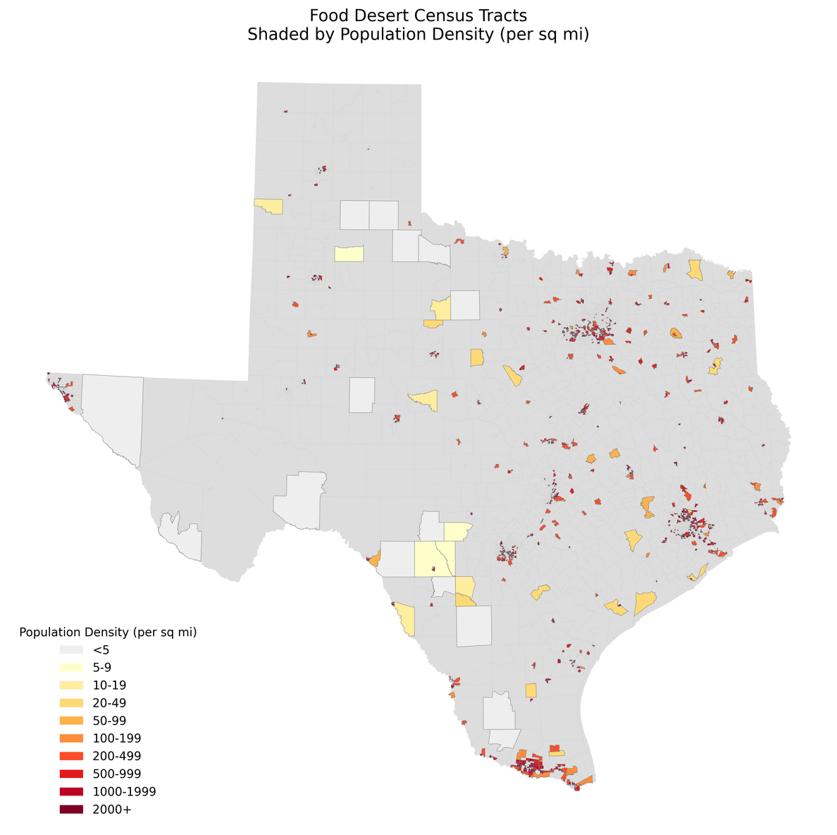
Oasis Initative
Texas Food Deserts
If we take a look at Texas we can various clusters scattered throughout the state. With a state this massive it would be impossible to service all these areas with the resources we currently possess. So we will have to further decrease our scope.

Slide 7
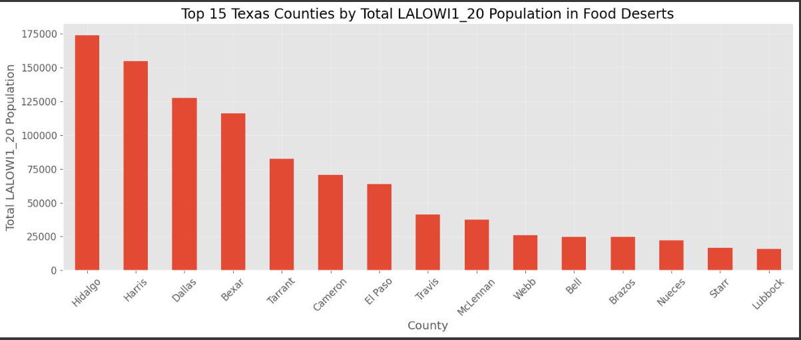
Oasis Initative
Where in Texas?
Texas Counties Sorted by LILA Population (1 and 20) | Texas Counties Sorted by LILA Population (1 and 20) | Texas Counties Sorted by LILA Population (1 and 20)
Total Census tracts | County Name | LALOWI Pop
59 | Hidalgo | 173,795
54 | Harris | 154,449
30 | Dallas | 127,590
8 | Bexar | 116,084
116 | Tarrant | 82,292
Reducing Scope
Even when the area is reduced to a single county it is still to large for launch. Oasis would have to further reduce the area it would serve initially.

Slide 8
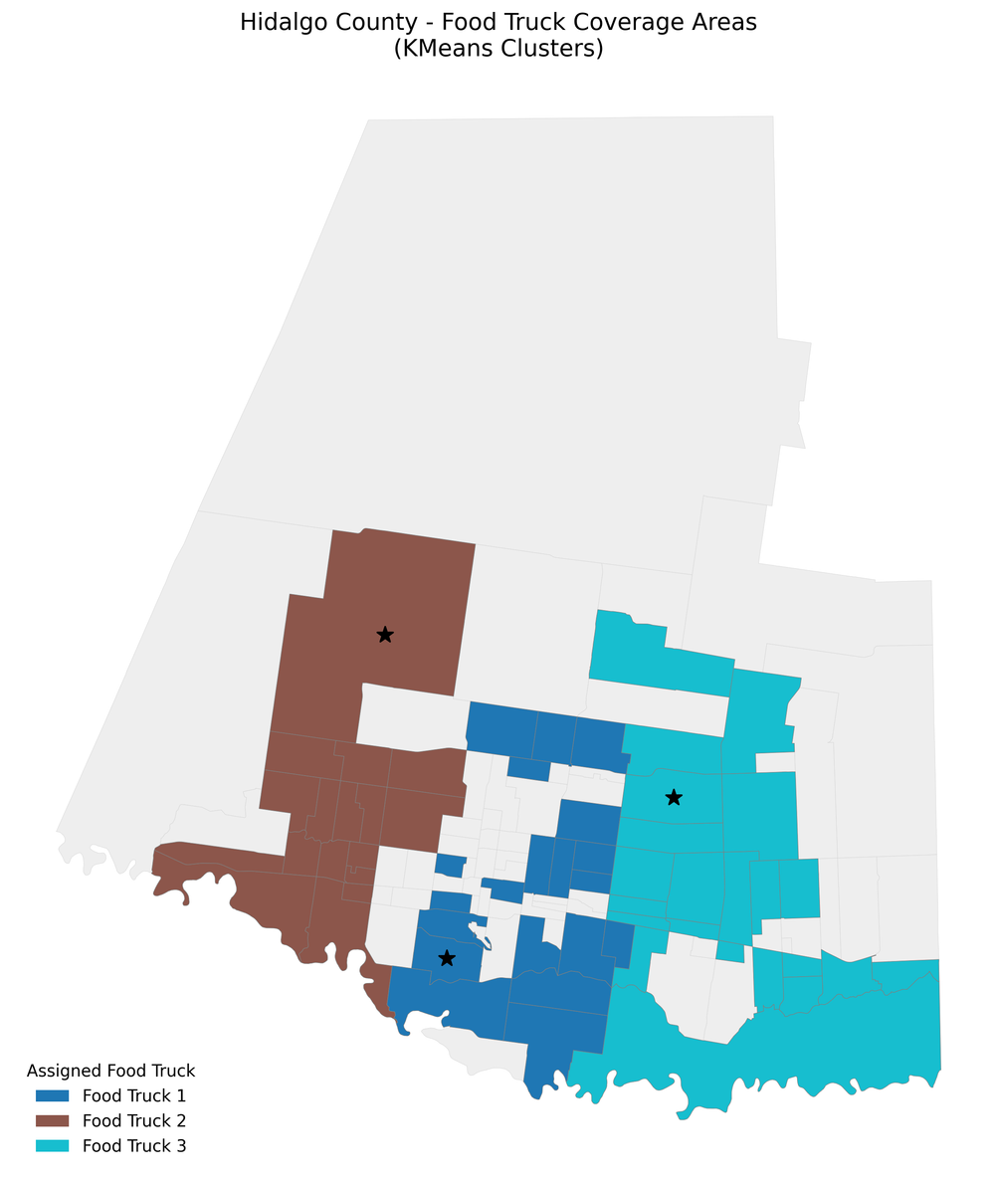


Oasis Initative
Hidalgo County
When we compared census tracts and considered things like population and distance, we found three potential areas for the truck to travel.

Slide 9
Oasis Initative
Texas Counties Sorted by LILA Population (1 and 20) | Texas Counties Sorted by LILA Population (1 and 20) | Texas Counties Sorted by LILA Population (1 and 20) | Texas Counties Sorted by LILA Population (1 and 20)
Route | Distance | Travel Time | People Served
1 | 11.29 | 12.23 | 17,117
2 | 24.52 | 12.49 | 29,716
3 | 11.09 | 12.22 | 27,454

Slide 10

Oasis Initative
Texas Counties Sorted by LILA Population (1 and 20) | Texas Counties Sorted by LILA Population (1 and 20) | Texas Counties Sorted by LILA Population (1 and 20) | Texas Counties Sorted by LILA Population (1 and 20)
Route | Distance | Travel Time | People Served
1 | 11.29 | 12.23 | 17,117
2 | 24.52 | 12.49 | 29,716
3 | 11.09 | 12.22 | 27,454
Texas Counties Sorted by LILA Population (1 and 20) | Texas Counties Sorted by LILA Population (1 and 20) | Texas Counties Sorted by LILA Population (1 and 20) | Texas Counties Sorted by LILA Population (1 and 20)
Route | Distance | Travel Time | People Served
1 | 11.29 | 12.23 | 17,117
2 | 24.52 | 12.49 | 29,716
3 | 11.09 | 12.22 | 27,454

Slide 11
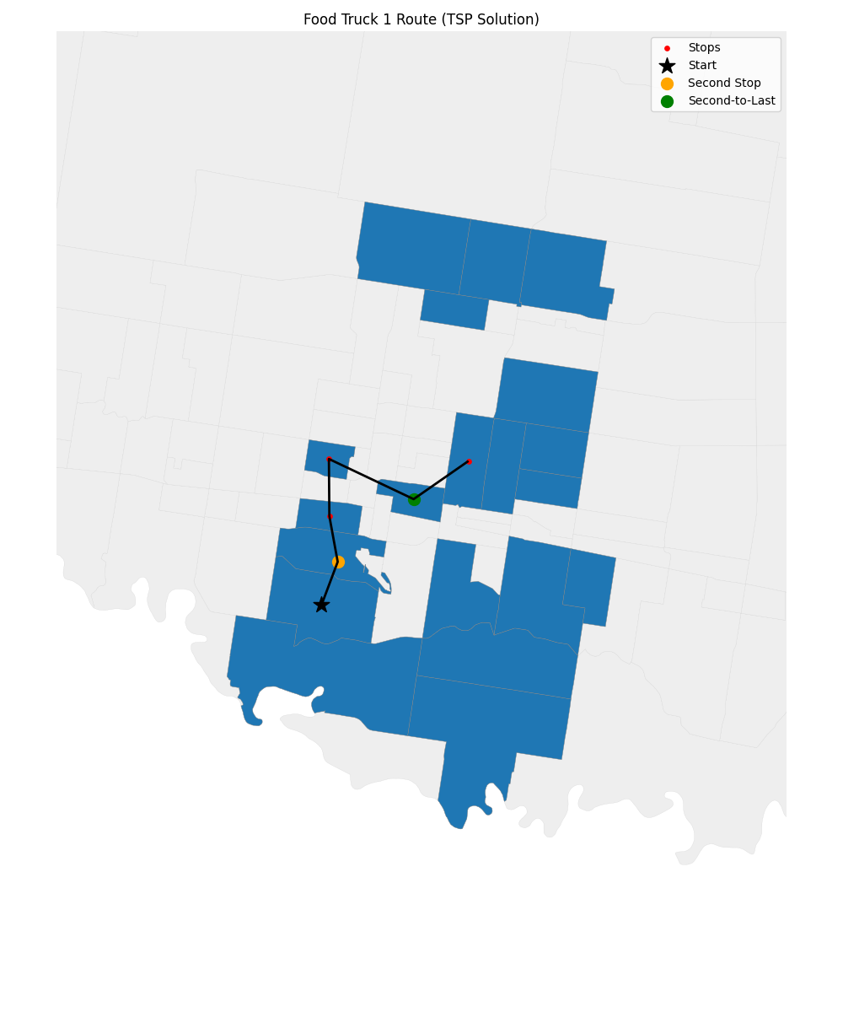
Oasis Initative
Optimized Route
According to our research this is our best route for potentially serving the most people in need.
It is based on a maximum travel limit of 14 hours with a two hour stop at each tract assuming that our truck is traveling at 50 mph.

Slide 12


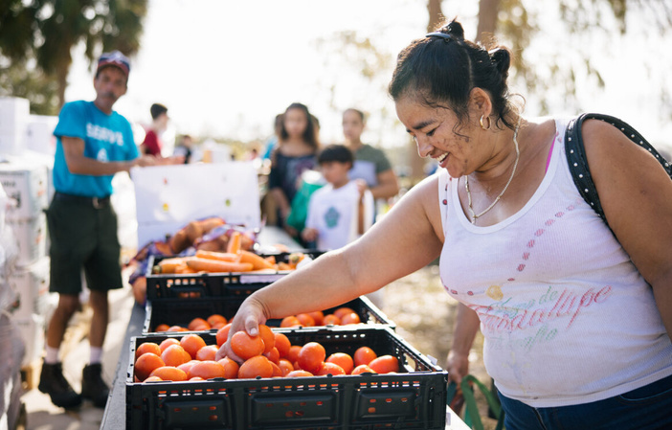
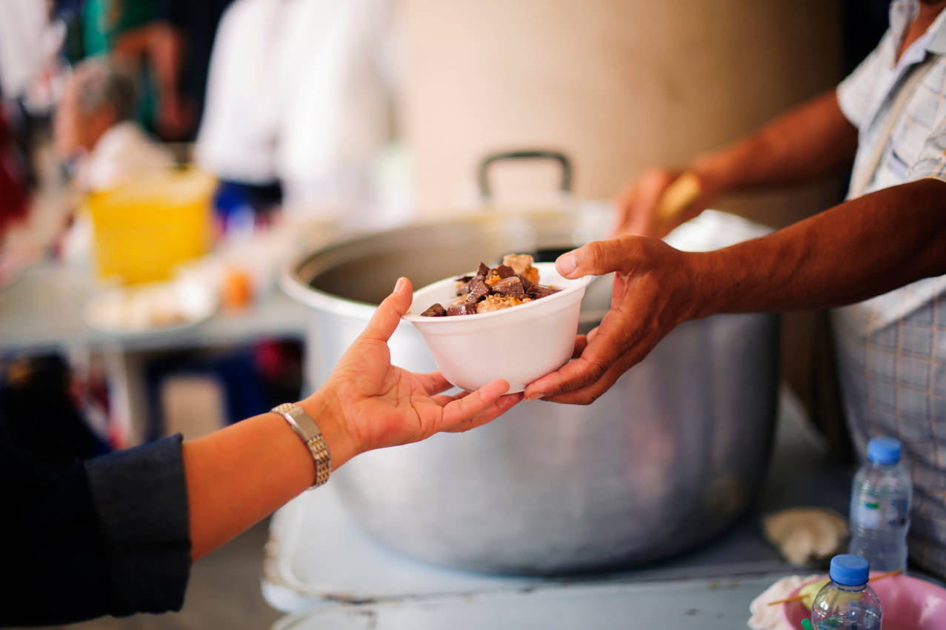

Community
Impact
With your continued assistance our impact can only continue to grow.
Directed Giving
Read About Robert’s Story

